Slide 1

Chapter 10
Competitive
Markets: Applications

Slide 2
Chapter Ten Overview
Motivation: Agricultural Price Supports
Deadweight Loss
A Perfectly Competitive Market Without Intervention Maximizes Total Surplus"
Government Intervention – Who Wins and Who Loses?
Examples of Various Government Polices
Excise Taxes
Price Ceilings and Floors
Production Quotas
Import Tariffs
Conclusions
Chapter Ten

Slide 3
Economic Efficiency
Definition: Economic Efficiency means that the total surplus is maximized.
"Every consumer who is willing to pay more than the opportunity cost of the resources needed to produce extra output is able to buy; every consumer who is not willing to pay the opportunity cost of the extra output does not buy.“
"All gains from trade (between buyers and suppliers) are exhausted at the efficient point."
The perfectly competitive equilibrium attains economic efficiency.
Note:
Chapter Ten

Slide 4
Surplus Maximization in Competitive Equilibrium
P
A
Supply
P^{d}
E
F
B
C
P*
P^{s}
G
D
Demand
Q₁
Q*
Q
Chapter Ten

Slide 5
Surplus Maximization in Competitive Equilibrium
At the Perfectly Competitive Equilibrium, (Q*,P*), Total Surplus is maximized.
Consumer's Surplus at (Q*,P*): ABC
Producer's Surplus at (Q*,P*) : DBC
Total Surplus at (Q*,P*): ADC
Chapter Ten

Slide 6
Deadweight Loss
Definition: A deadweight loss is a reduction in net economic benefits resulting from an inefficient allocation of resources.
Consumer's Surplus at (Q₁,P^{d}): AEF
Producer's Surplus at (Q₁,P^{d}) : EFGD
Total Surplus at (Q₁,P^{d}): AFGD
Deadweight Loss at (Q₁,P^{d}): AFC
Chapter Ten

Slide 7
Government Intervention: Winners & Losers
Intervention Type | Effect on (domestic) quantity traded | Effect on (domestic) Consumer Surplus | Effect on (domestic) Producer Surplus | Effect on (domestic) Government Budget | Is a (domestic) Deadweight Loss created?
Excise Tax | Falls | Falls | Falls | Positive | Yes
Subsidies to Producers | Rises | Rises | Rises | Negative | Yes
Maximum Price Ceilings for Producers | Falls; Excess Demand | Rise or Fall | Falls | Zero | Yes
Minimum Price Floors for Producers | Falls; Excess Supply | Falls | Rise or Fall | Zero | Yes
Production Quotas | Falls; Excess Supply | Falls | Rise or Fall | Zero | Yes
Import Tariffs | Falls | Falls | Rises | Positive | Yes
Import Quotas | Falls | Falls | Rises | Zero | Yes
Chapter Ten

Slide 8
Policy: Excise Tax
Definition: An excise tax (or a specific tax) is an amount paid by either the consumer or the producer per unit of the good at the point of sale.
(The amount paid by the demanders exceeds the total amount received by the sellers by amount T)
Chapter Ten

Slide 9
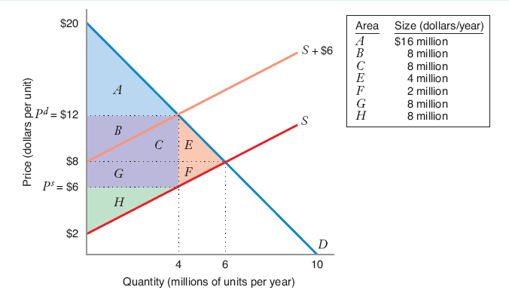
Policy: Excise Tax
Chapter Ten

Slide 10
Policy: Excise Tax
 | With No Tax | With Tax | Impact of Tax
Consumer Surplus | A + B + C + E | A | - B - C - E
Producer Surplus | F + G + H | H | - F - G
Government Receipts from Tax | Zero | B + C + G | B + C + G
Net Benefits | A + B + C + E + F + G + H | A + B + C + G + H | - E – F
Deadweight Loss | Zero | E + F | E + F
Chapter Ten

Slide 11
Key Definitions
Definition: Incidence of a tax is a measure of the effect of a tax on the prices consumers pay and sellers receive in a market.
Definition: The amount by which the price paid by buyers, P^{d}, rises over the non-tax equilibrium price, P*, is the incidence of the tax on consumers; the amount by which the price received by sellers, P^{s}, falls below P* is called the incidence of the tax on producers.
Chapter Ten

Slide 12
Incidence of Tax in Two Extreme Cases
P
P^{d}=P*+T
S’
T
P^{s} = P*
S
P
S
D
Case II
Q
Case I
P^{d} = P*
T
P^{s} = P*-T
Q
D
Chapter Ten

Slide 13
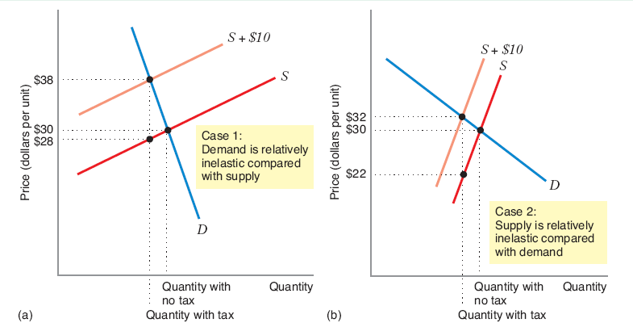
Incidence of Tax in Two Cases
Chapter Ten

Slide 14
Back of the Envelope
"Back of the Envelope" method to calculate the incidence of a specific tax
ΔP^{d}/ΔP^{s} = η/ε
where: η is the own-price elasticity of supply ε is the own-price elasticity of demand
Chapter Ten

Slide 15
Back of the Envelope
Why – consider a small tax applied to an economy at point (Q*,P*)
ε =(ΔQ/Q*)/(ΔPd/P*)…⬄ ΔQ/Q*=ΔPd/P*ε
η =(ΔQ/Q*)/(ΔPs/P*)…⬄ ΔQ/Q*=ΔPs/P*η
but for market to clear, ΔQ/Q* must be the same for demand and supply, hence
ΔPd/P*ε = ΔPs/P*η
Chapter Ten

Slide 16
Tax Effect
Example: Let ε = -.5 and η = 2. What is the relative incidence of a specific tax on consumers and producers?
ΔPd/ΔPs = 2/-.5 = -4
interpretation: "consumers pay four times as much as the decrease in price producers receive. Hence, an excise tax of $1 results in an increase in consumer price of $.8 and a decrease in price received by producers of $.2"
Note: Subsidies are negative taxes.
Chapter Ten

Slide 17
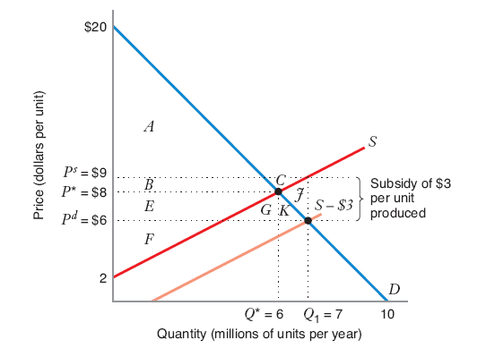
Subsidies
Chapter Ten

Slide 18
Subsidies
 | With No Subsidy | With Subsidy | Impact of Subsidy
Consumer Surplus | A + B | A + B + E + G + K | - B - C - E
Producer Surplus | E + F | B + C + E + F | - F - G
Impact on Government Budget | Zero | - B - C - E - G - K - J | B + C + G
Net Benefits | A + B + E + F | A + B + E + F – J | - E - F
Deadweight Loss | Zero | J | J
Chapter Ten

Slide 19
Policy: Price Ceilings
Definition: A price ceiling is a legal maximum on the price per unit that a producer can receive. If the price ceiling is below the pre-control competitive equilibrium price, then the ceiling is called binding.
Chapter Ten

Slide 20
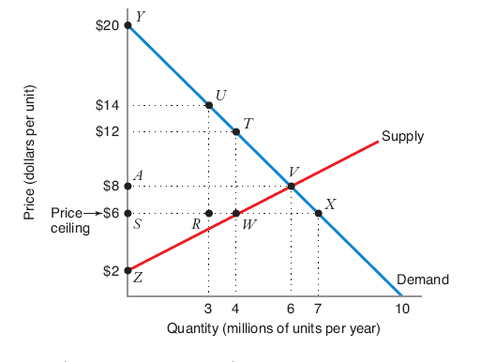
Policy: Price Ceilings
Chapter Ten

Slide 21
Policy: Price Ceilings
 | With No Price Ceiling | With Price Ceiling
 |  | With Maximum Consumer Surplus | With Minimum Consumer Surplus
Consumer Surplus | Area YAV | Area YTWS | Area URX
Producer Surplus | Area AVZ | Area SWZ | Area SWZ
Net Benefits | Area YZV | Area YTWZ | Areas URX + SWZ
Deadweight Loss | Zero | Area TWV | Area YZV – Area URX – Area SWZ
Chapter Ten

Slide 22
Policy: Price Floor
Definition: A price floor is a minimum price that consumers can legally pay for a good. Price floors sometimes are referred to as price supports. If the price floor is above the pre-control competitive equilibrium price, it is said to be binding.
Chapter Ten

Slide 23
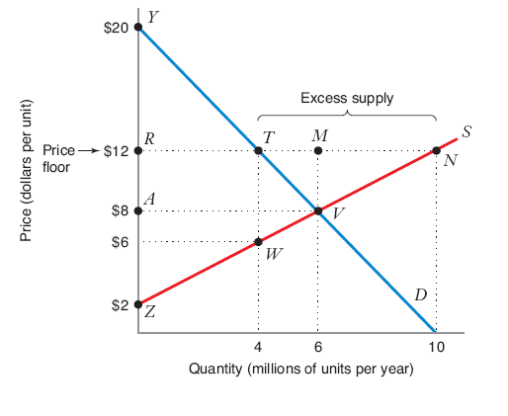
Policy: Price Floor
Chapter Ten

Slide 24
Policy: Price Floor
 | With No Price Floor | With Price Floor
 |  | With Maximum Producer Surplus | With Minimum Producer Surplus
Consumer Surplus | Area YAV | Area YTR | Area YTR
Producer Surplus | Area AVZ | Area RTWZ | Area MNV
Net Benefits | Area YZV | Area YTWZ | Areas YTR + MNV
Deadweight Loss | Zero | Area TWV | Area YZV – Area YTR – Area MNV
Chapter Ten

Slide 25
Policy: Import Tariffs & Quotas
Definition: Tariffs are taxes levied by a government on goods imported into the government's own country. Tariffs sometimes are called duties.
Definition: An import quota is a limit on the total number of units of a good that can be imported into the country.
Chapter Ten

Slide 26
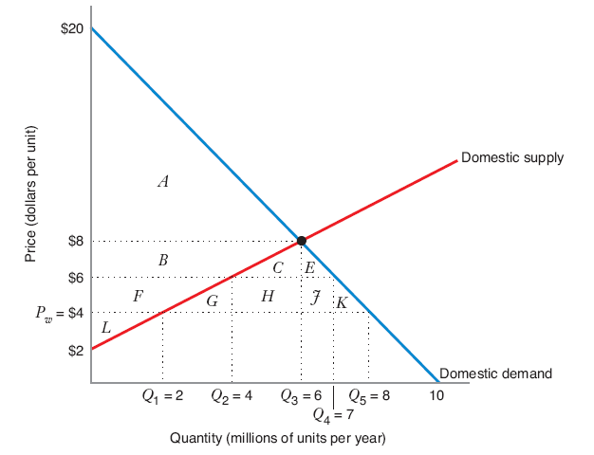
Policy: Import Quotas
Chapter Ten

Slide 27
Policy: Import Quotas
 | Free Trade (with no quota) | With Quota |  | Impact of Quota
 |  | Trade Prohibition (quota = 0) | Quota = 3 Million Units per year | Impact of Trade Prohibition | Impact of Quota = 3 Million Units per year
Consumer Surplus | A + B + C + E + F + G + H + J + K | A | A + B + C + E | - B - C - E - F - G - H - J – K | - F - G - H - J - K
Producer Surplus | L | B + F + L | F + L | B + F | F
Net Benefits | A + B + C + E + F + G + H + J + K + L | A + B + F + L | A + B + C + E + F + L | - C - E - G - H - J - K | - G - H - J - K
Deadweight Loss | Zero | C + E + G + H + J + K | G + H + J + K | C + E + G + H + J + K | G + H + J + K
Producer Surplus (foreign) | Zero | Zero | H + J | Zero | H + J
Chapter Ten

Slide 28
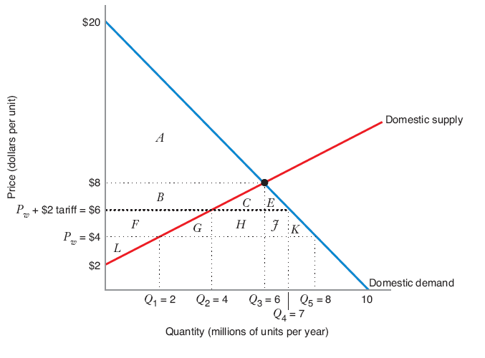
Policy: Import Tariffs
Chapter Ten

Slide 29
Policy: Import Tariffs
 | Free Trade (with no tariff) | With Tariff | Impact of Tariff
Consumer Surplus | A + B + C + E + F + G + H + J + K | A + B + C + E | - F - G - H - J - K
Producer Surplus | L | F + L | F
Impact on Government Budget | Zero | H + J | H + J
Net Benefits | A + B + C + E + F + G + H + J + K + L | A + B + C + E + F + L | - G - H - J – K
Deadweight Loss | Zero | G + K | G + K
Producer Surplus (foreign) | Zero | Zero | Zero
Chapter Ten

Slide 30
Comparing a Tariff to a Quota
Let quota limit imports to Q3-Q2…the equilibrium price would be the same as for the tariff…and the (world) deadweight loss would be the same as well.
Is there a difference? The quota generates no government revenue. Hence, while the total supply and total price for the domestic market remains the same under the two policies, domestic deadweight loss is larger under the quota.
Chapter Ten

